Slide 1

Capstone Design Review Presentation

Slide 2
Designing and Evaluating a Retrieval-Augmented LLM System
Ojer Paz Montiel | Research Papers Navigator
Add slide title
Research Paper Navigator was developed to help users interact with a collection of research papers through natural language. Instead of manually reviewing dozens of documents, users can ask questions and receive grounded answers supported by citations and direct quotations.
The goal of this project is to transform a collection of research papers into a conversational research assistant that supports retrieval, comparison, trend analysis, and citation-backed answers.

Slide 3
The Problem
What Problem Does the System Solve?
Research Paper Navigator helps users interact with a collection of research papers through natural language questions. Instead of manually searching and reviewing individual PDFs, users can ask questions and receive evidence-based answers supported by retrieved passages, paper references, and page-level citations.
Who Is the Intended User?
The system is designed for students, researchers, and knowledge workers who need to locate, understand, compare, and verify information across multiple research papers efficiently.
Why Is This Problem Important?
Literature reviews often require significant time and effort to find relevant information and verify supporting evidence. Research Paper Navigator improves research efficiency by retrieving relevant passages and providing citation-supported answers that can be traced back to the original source. The system assists the research process while preserving transparency and human verification.
RAG is used to ground the LLM's responses in retrieved research-paper evidence, enabling more accurate, transparent, and citation-supported answers.

Slide 4
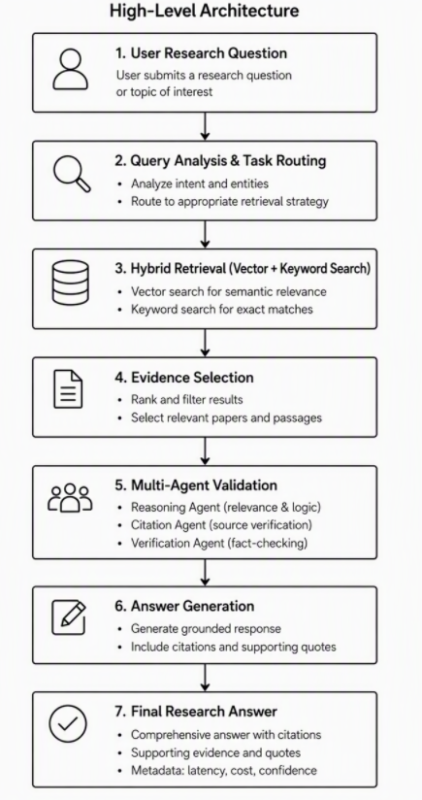
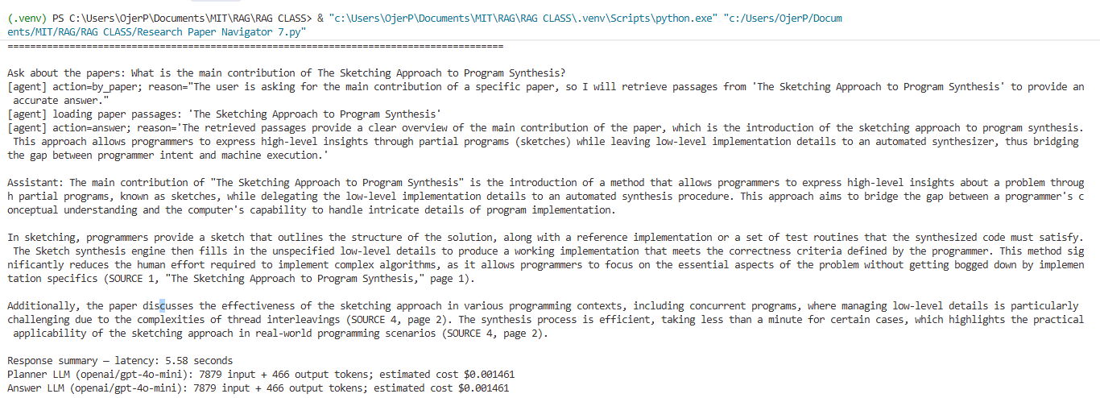
The Solution
High-Level Architecture
Offline Stage
PDF Processing
Text Chunking
Hybrid Index Creation
Online Stage
Evidence Retrieval
Agent Reasoning
Citation-Based Answer Generation
Workflow
Research Papers → Chunking → Hybrid Retrieval → LangGraph Agent → LLM → Cited Answer
Outcome: Users receive grounded answers supported by verifiable paper and page citations.
Notes:
High-Level Architecture
My system has two stages. First, an offline indexing stage processes research-paper PDFs, extracts and cleans their text, divides it into overlapping chunks, and indexes those chunks for search. Second, an online question-answering stage retrieves relevant chunks, gives them to a language model as evidence, and generates a cited response.
Code example: extract_pdf_chunks() handles PDF text and chunk creation; build_or_load_db() creates or loads the Chroma vector database. The app also builds a BM25 keyword index when it starts.
Major Workflow Components
The main components are PDF processing, chunking and metadata, the vector and BM25 indexes, the hybrid retriever, the LangGraph planner, and the answer model. The planner can search, load passages from a named paper, ask for clarification, or decide that there is enough evidence to answer.
Code example: AgentState tracks conversation history, executed queries, retrieved chunks, and the agent’s iteration count. The graph routes among retrieve, by_paper, clarify, and answer.
How Retrieval, Reasoning, and Generation Work Together
When a user asks a question, retrieval finds candidate passages in two ways: BM25 searches for matching terms, while vector search finds semantically related text. The system combines their normalized scores, then the planner considers the question and evidence and may request additional searches. Once it decides there is enough evidence, the answer model generates a response using the retrieved passages and is prompted to cite paper titles and pages.
Code example: BM25 and vector scores each have a weight of 0.5. The agent can run for up to five iterations, and the answer prompt receives up to 12 chunks. The code requests citations, but it does not independently verify them.

Slide 5
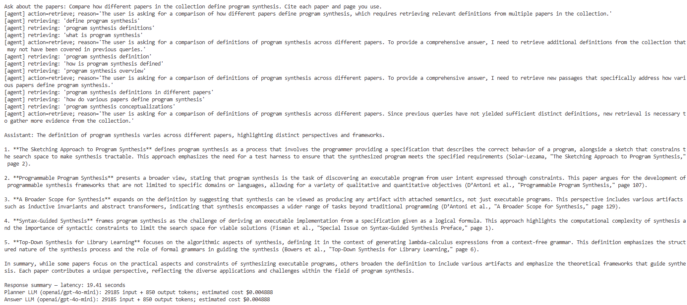
The Solution
Specific-paper search: “In The Sketching Approach to Program Synthesis, what is a sketch, what does the programmer provide, and what does the synthesizer complete? Cite the paper title and page.”This tests whether PDF text was indexed into searchable chunks and whether the page metadata supports a traceable citation.
Collection-wide comparison: “Compare how different papers in the collection define program synthesis. Cite each paper and page you use.”This tests keyword and semantic retrieval across papers, followed by the agent’s evidence gathering and citation-supported answer generation.
Notes:
High-Level Architecture
extract_pdf_chunks() applies this to each PDF page and stores each chunk with its paper title, filename, and page number. build_or_load_db() creates or loads the Chroma vector database. The app also builds a BM25 keyword index from the chunks.
Example outcome: A PDF page becomes one or more searchable chunks. Each chunk retains metadata such as its source paper and page, so the system can provide a page citation later.
Major Workflow Components
he LangGraph planner can route to retrieve, by_paper, clarify, or answer.Example outcome from a live run: When asked about the main contribution of The Sketching Approach to Program Synthesis, the planner selected by_paper, loaded passages for that paper, then selected
How Retrieval, Reasoning, and Generation Work Together
The weights are set to 0.5 for BM25 and 0.5 for vector search. The planner can request additional retrieval, with a limit of five iterations; the answer prompt receives up to 12 chunks.Example question used in the live run:Quote the first sentence of the abstract of The Sketching Approach to Program Synthesis.The planner chose retrieve, searched for relevant passages, and the answer model returned:“Sketching is a new form of localized software synthesis that aims to bridge the gap between a programmer’s high-level insights about a problem and the computer’s ability to manage low-level details” (SOURCE 1, “The Sketching Approach to Program Synthesis,” page 1).This shows the full path: question → retrieval → planner → answer with citation. The code prompts the model to cite sources, but it does not independently verify the citation against the PDF
Specific-paper search: “In The Sketching Approach to Program Synthesis, what is a sketch, what does the programmer provide, and what does the synthesizer complete? Cite the paper title and page.”This tests whether PDF text was indexed into searchable chunks and whether the page metadata supports a traceable citation.Collection-wide comparison: “Compare how different papers in the collection define program synthesis. Cite each paper and page you use.”This tests keyword and semantic retrieval across papers, followed by the agent’s evidence gathering and citation-supported answer generation.

Slide 6
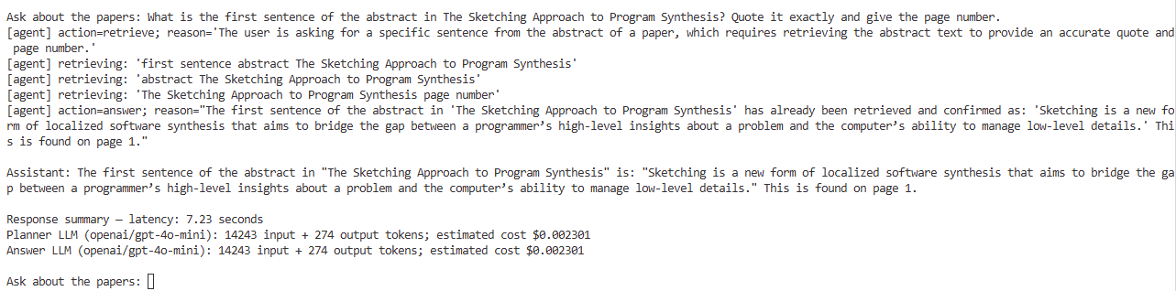
Retrieval and Evaluation
Simple Presentation Example
Question: “What is the main idea of The Sketching Approach to Program Synthesis?”
What the system does: It searches the papers twice: once for matching words and once for similar meaning. It combines the results and selects the five most relevant passages.
Example answer: The paper describes “sketches,” or incomplete programs, that a computer completes. The answer should cite the paper and page number.
How I test it: I check whether the right paper and passage were found, and whether the answer’s citation matches the PDF.
Strength: It can find useful passages even when the question uses different wording.
Limitation: It may miss evidence, and scanned PDFs may not work because the system does not use OCR.
Notes:
Test question: “What is the first sentence of the abstract in The Sketching Approach to Program Synthesis? Quote it exactly and give the page number.”Check that the retrieved passage contains the same sentence and that the cited page matches the PDF. This directly verifies retrieval and citation accuracy.

Slide 7
Engineering Decisions
Decision | Why It Was Chosen | Trade-Off
Page-A | Preserves paper title and page number, enabling traceable citations. | Tables, figures, and scanned PDFs require OCR support.
Hybrid Retrieval (BM25 + Vector Search) | Combines keyword matching with semantic search to improve evidence retrieval. | More complex than using a single retrieval method.
Top-5 Evidence Selection | Reduces prompt size and improves response speed. | Some relevant evidence may be excluded.
5-Agent Iteration Limit | Controls latency and token consumption. | Additional reasoning opportunities are limited.
Persistent Chroma Index | Avoids reprocessing and re-embedding unchanged documents. | Index must be rebuilt when the document collection changes.
PDF Validation Pipeline | Verifies extraction quality, metadata accuracy, and chunk consistency before indexing. | Adds preprocessing time but improves retrieval reliability.
Notes:
Design Decisions: Balancing Quality, Latency, and Cost
PDF processing: PyMuPDF extracts text page by page; clean_pdf_text() fixes some formatting artifacts. Chunks contain 320 words with 60 words of overlap and retain page metadata. Challenge: scanned PDFs need OCR, which this code does not provide; tables and figures are not extracted.
Retrieval: The system combines BM25 keyword search with Chroma vector search, weighted 50/50. This balances exact-term matching with semantic similarity. BM25-only or vector-only retrieval were alternatives, but each misses some relevant wording.
Context and latency: The retriever returns five chunks per query by default, while the answer prompt allows up to 12 chunks. The planner is limited to five iterations. Larger limits could improve coverage but increase prompt size, latency, and token cost.
Indexing cost: Chroma is persisted and reused when the corpus fingerprint is unchanged, avoiding repeated embedding work. If the corpus changes or a rebuild is requested, PDFs are reprocessed and embeddings are generated again.
Why this approach: “I chose page-aware chunking and hybrid retrieval to provide useful, traceable evidence, then bounded retrieved context and agent iterations to keep response time and token use under control. These settings are practical starting points; they have not been tuned through a formal performance benchmark.”

Slide 8
Limitations and Future Improvements
Current Limitations | Key Risks | Future Enhancements
Retrieval parameters are fixed and not yet optimized through benchmarking. Difuculties in PDF conversion | Broad comparison questions may require more evidence than the current context window allows. | Add layout-aware extraction for tables, figures, and complex document structures
Fixed chunking strategy and retrieval weights | Broad comparison questions may require more evidence than the current context window provides | Retrieval tuning and adaptive chunking
Citations are generated but not independently verified | Citations may not always fully support generated claims | Automated citation verification
Evaluation is primarily qualitative and not benchmark-driven | Retrieval quality and answer accuracy are not systematically measured | Labeled evaluation dataset and Benchmark framework
No OCR support for scanned PDFs, tables, or figures | Relevant evidence may not be included in the retrieved chunks | OCR and layout-aware document processing
Notes:
Remaining Limitations
PDF extraction: The code extracts text but does not perform OCR or extract tables and figures. A scanned paper may produce little or no usable text.
Retrieval quality: Chunk size and the 50/50 BM25/vector weighting are fixed; there is no separate reranker.
Citation reliability: The answer prompt requests citations, but the system does not independently verify that a cited page supports each claim.
Evaluation: The code lists test questions but does not automatically score retrieval quality, factual accuracy, or citation accuracy.
Example: For a scanned PDF, the system may have no text chunks to retrieve, so it may be unable to answer even if the information is visible on the page.
Known Risks
A relevant passage may not appear among the limited retrieved chunks, especially for broad comparison questions.
Retrieved PDF text could contain misleading instructions. The prompts treat it as untrusted data, but this is not a guarantee against prompt injection.
Estimated costs use approximate configured prices and may not match current provider pricing.
Example: A comparison question may require evidence from many papers, but the answer model receives at most 12 chunks.
Future Enhancements
Add OCR and layout-aware extraction for scanned PDFs, tables, and figures.
Build a labeled evaluation set; measure retrieval relevance, answer correctness, and citation accuracy.
Tune chunking, retrieval weights, and result limits against that evaluation set.
Add reranking and automated checks that each answer claim is supported by its cited passage.
Track actual provider costs and compare latency and quality across configurations.
Closing line: “The current system demonstrates the RAG workflow, while OCR, systematic evaluation, and citation verification are the next steps toward more reliable use.”

Slide 9
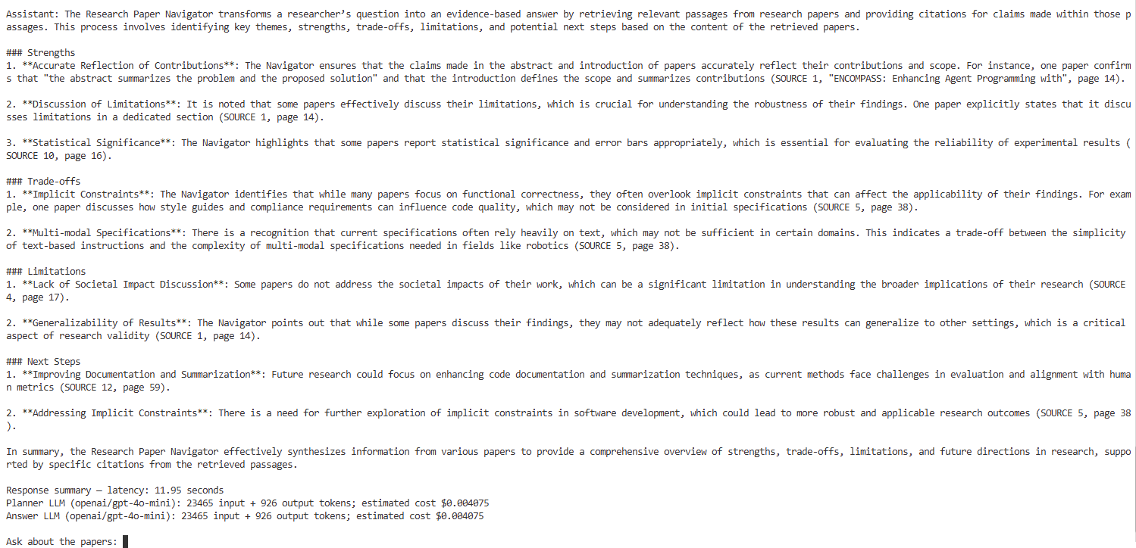
Example

Slide 10
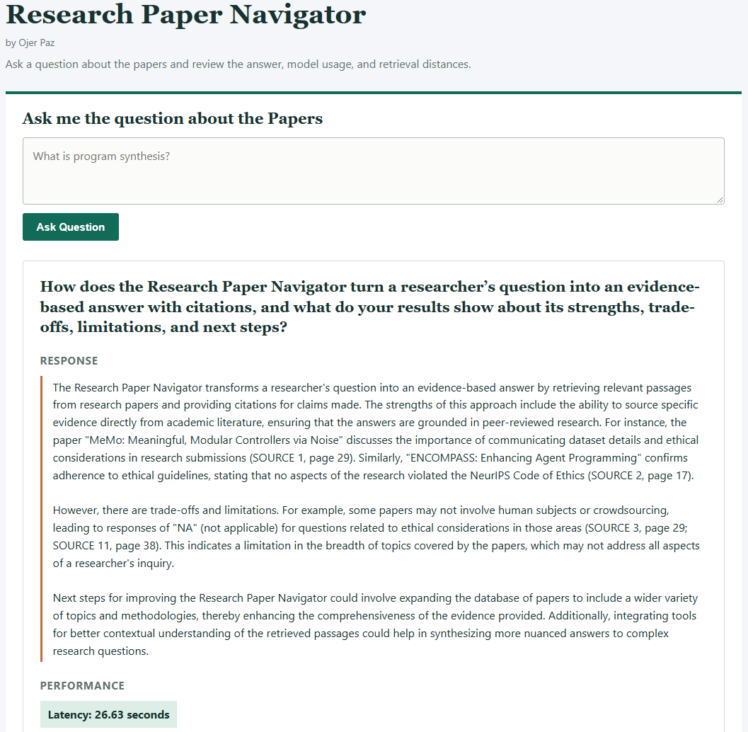
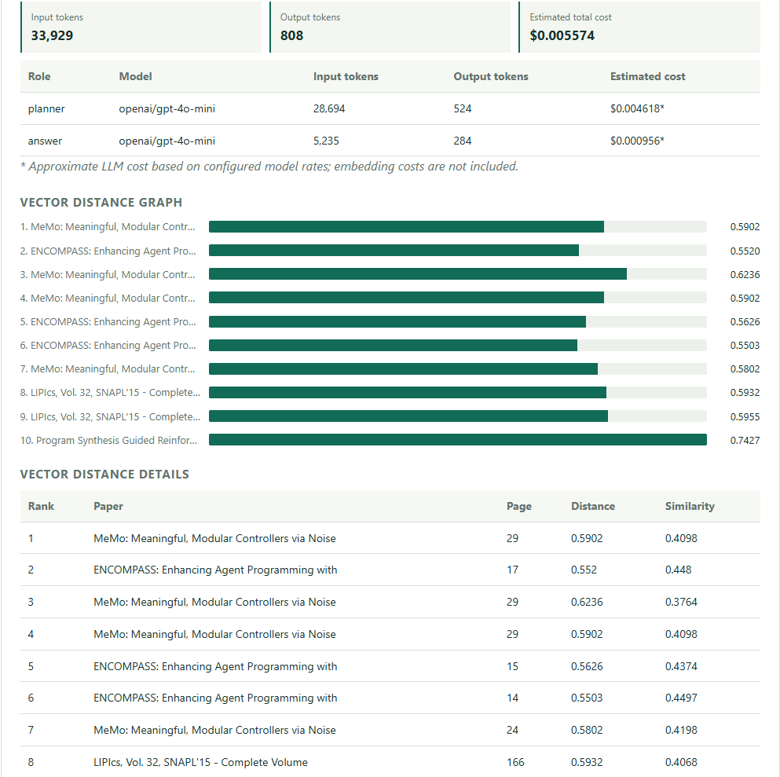
Example of Version

Slide 11
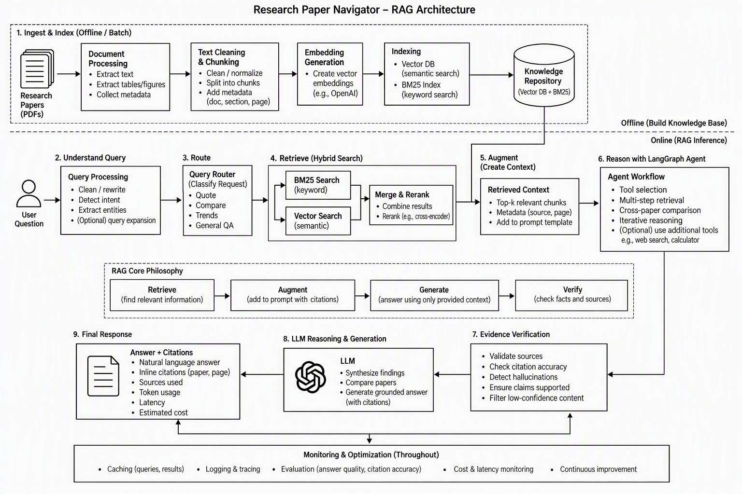

Slide 12
Questions
Thank you!

